Slide 1

Multivariate Linear Regression

Slide 2
Couple of words
The goal in any data analysis is to extract from raw information
the accurate estimation.
One of the most important and common question concerning if there is statistical relationship between a response variable (Y) and explanatory variables (Xi).
An option to answer this question is to employ regression analysis in order to model its relationship. There are various types of regression analysis.
The type of the regression model depends on the type of the distribution of Y; if it is continuous and approximately normal we use linear regression model; if dichotomous we use logistic regression; ……
By modeling we try to predict the outcome (Y) based on values of a set of predictor variables (Xi).
These methods allow us to assess the impact of multiple variables (covariates and factors) in the same model.

Slide 3
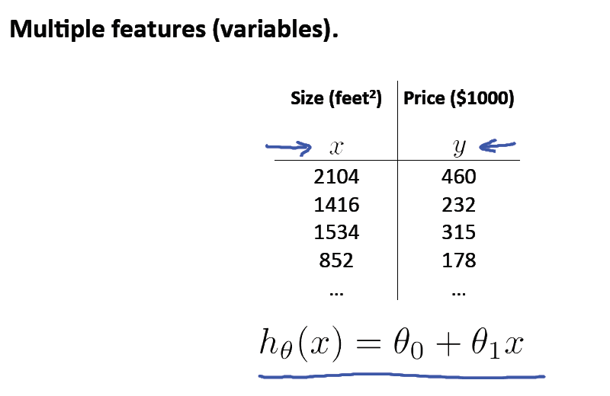

Slide 4
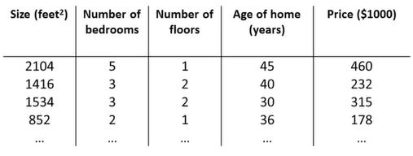
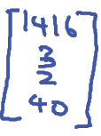
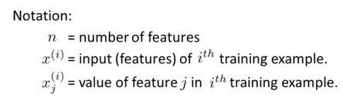


Multiple variables
x1
x2
x3
x4
y
m=47
n=4
$$x^{2}=$$
=?

Slide 5
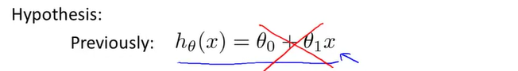
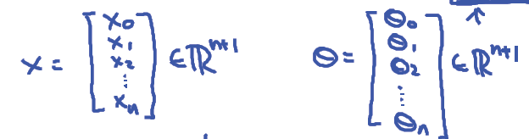
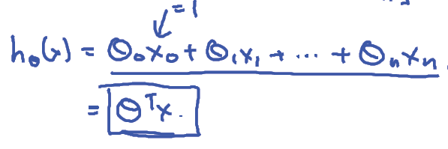


$$h_{θ}(x)=θ_{0}+θ_{1}x_{1}+θ_{2}x_{2}+θ_{3}x_{3}+θ_{4}x_{4}$$
$${E.g.: h}_{θ}(x)=80+0.1x_{1}+0.01x_{2}+3x_{3}+4x_{4}$$

Slide 6
Gradient Descent for Multiple Variables

Slide 7
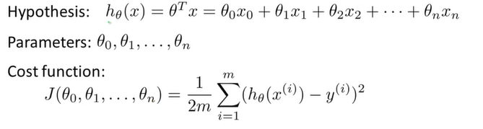
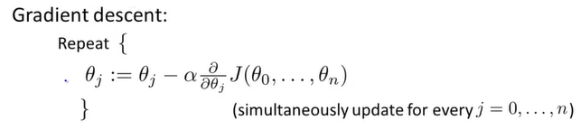

Summarizing previous slides
$x_{0}=$1
Θ – vector with n+1 dimension

Slide 8
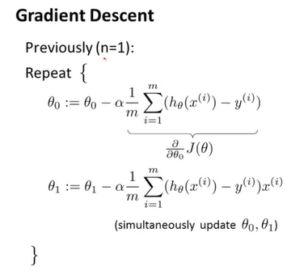
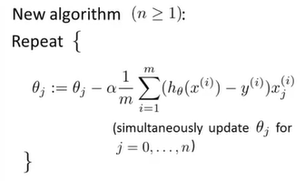
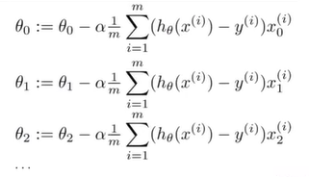

Slide 9
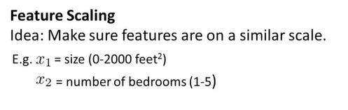
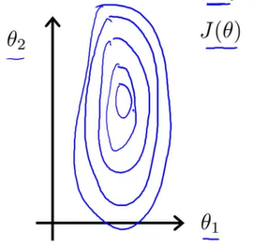
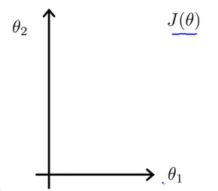
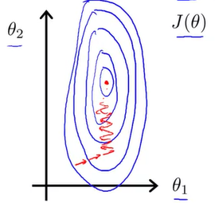
Gradient Descent in Practice
Very long time to find a global minimum.
In this settings, the useful thing to do is – FEATURE SCALING

Slide 10
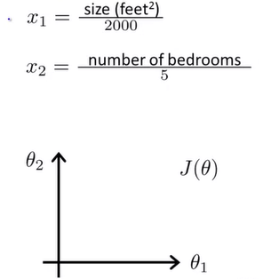
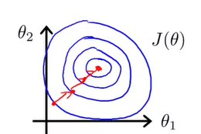
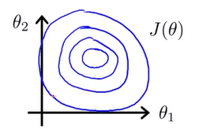


0≤$x_{1}\text{≤}\text{1}$
0≤$x_{2}\text{≤}\text{1}$
Much more direct path!

Slide 11

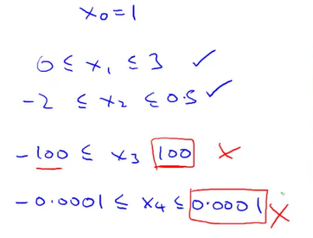
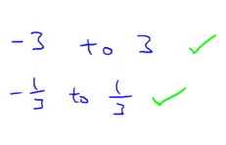

Slide 12
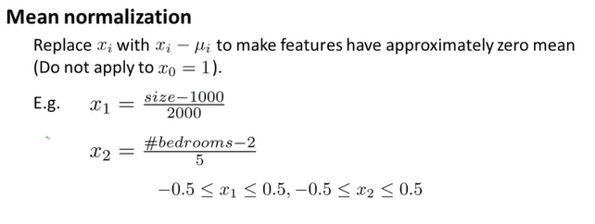
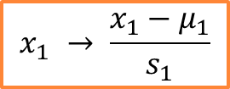
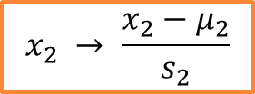
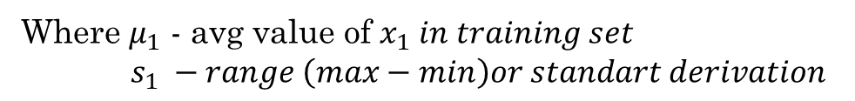
$$x_{1} → \frac{x_{1}−μ_{1}}{s_{1}}$$
Where $μ_{1}$ - avg value of $x_{1} in training set$
$s_{1} −range \left(max−min\right)or standart derivation$
$$x_{2} → \frac{x_{2}−μ_{2}}{s_{2}}$$
…

Slide 13
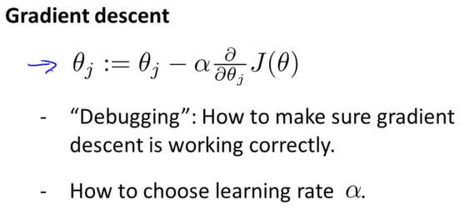
Plan

Slide 14
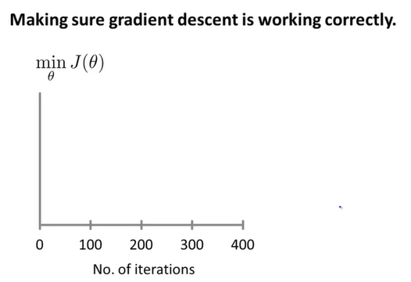
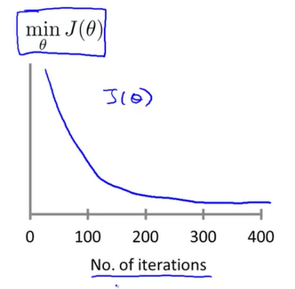
Plot each J(θ) through the iteration
After 100 iterations we get some value of θ. So we plot the value of J(θ). The same for 200, 300,… iterations
So the Gradient Descent is working properly, if J(θ) is decreasing after each iteration!

Slide 15
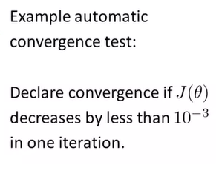
Another way to test convergence
For different learning algorithms the convergence of Gradient Descent could be different!

Slide 16
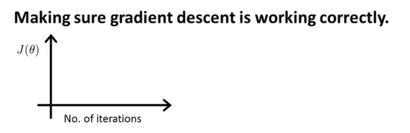
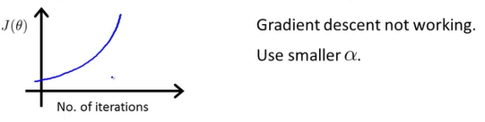
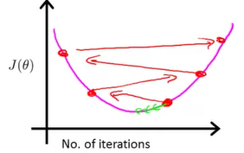
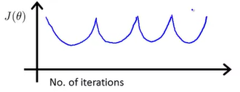

Usually using too big alpha causes overshooting the global minimum!

Slide 17
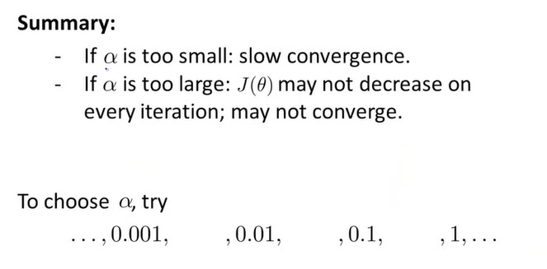

Slide 18
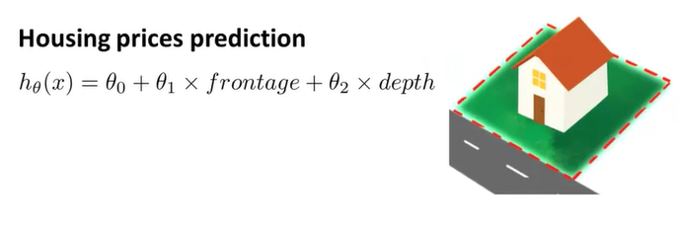
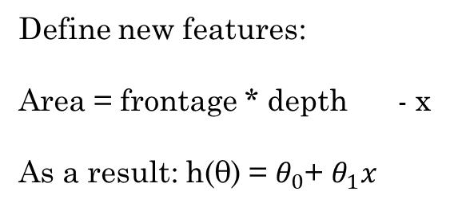
Features and polynomial regression
x2
x1
Define new features:
Area = frontage * depth - x
As a result: h(θ) = $θ_{0}$+ $θ_{1}x$
Better model

Slide 19
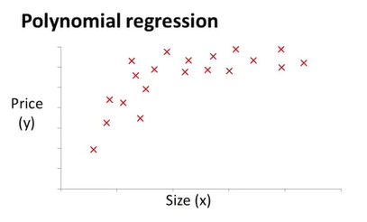
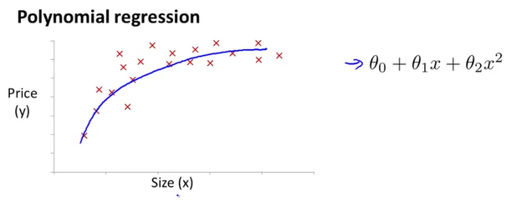
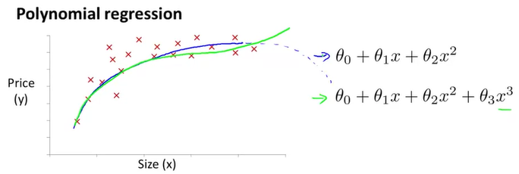
Quadratic function.
But actually it does not make sense…
Because it eventually it should decrease ;(
MAY BE
Cubic function?

Slide 20
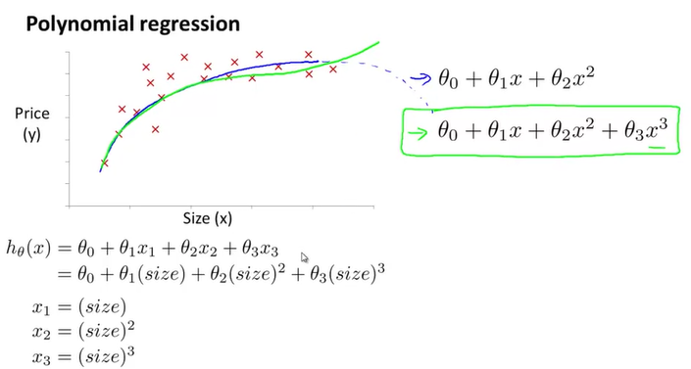
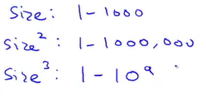
Here feature scaling become increasingly important!
Because:

Slide 21
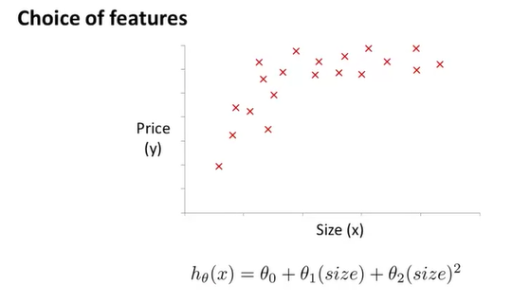

Does not goes down
Not very good…
Another reasonable choice

Slide 22
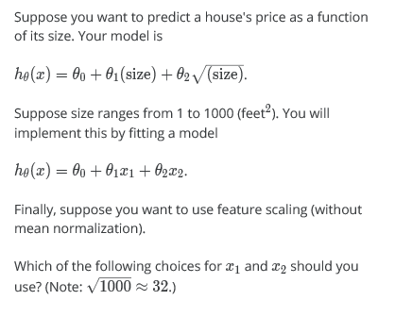
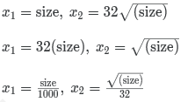

Example

Slide 23
Computing Parameters Analytically

Slide 24
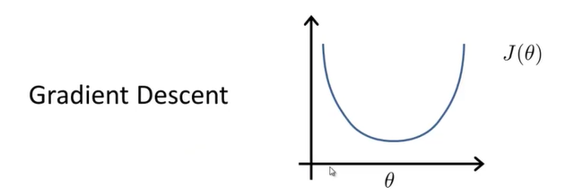

Normal Equation
The normal equation for some linear regression problems, will give us a much better way to solve for the optimal value of the parameters theta.
Algorithm for the linear regression is Gradient Descent.
In Gradient Descent in order to converge to global minimum we do an iterative steps.

Slide 25
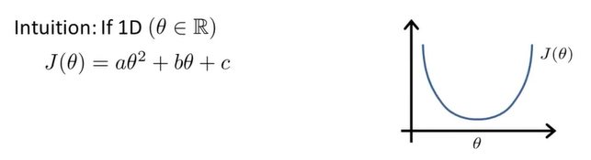
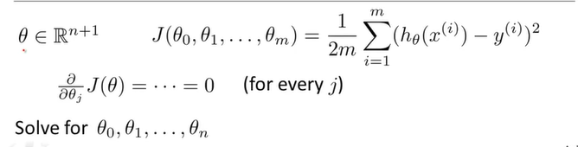

Some Intuition of Normal Equation
Theta is just a row value
How do you minimize a quadratic function?
From Calculus we know:
$\frac{d}{dθ}$J = ……. = 0
What if theta is no longer just a real number, but, instead, is this n+1-dimensional parameter vector

Slide 26
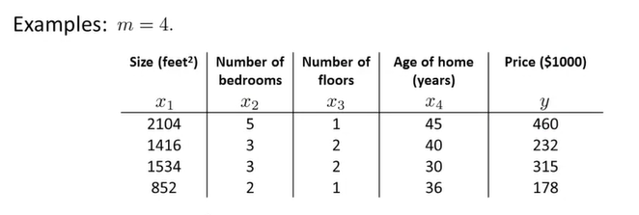

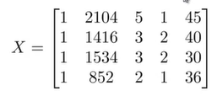
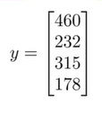

Add
(m x n+1)
m – dimensional vector

Slide 27





More about equation

Slide 28


Training

Slide 29




No need to do features scaling, although of course if you are using gradient descent, then, features scaling is still important

Slide 30



if n is relatively small,
then the normal equation might give you a better way to solve the parameters
What does small and large mean?
the number of features is less than 1000

Slide 31
Normal Equation Noninvertibility

Slide 32

Exception

Slide 33



the algebra actually shows that if your two features are related, are a linear equation
Solutions to the above problems include deleting a feature that is linearly dependent with another or deleting one or more features when there are too many features.

